Slide 1


AI BASED VIRTUAL VOICE ASSISTANT FOR AUTOMATION
NADAR SARASWATHI COLLEGE OF ENGINEERING AND TECHNOLOGY
Department of Electronics And Communication Engineering
Presented by
Guided By
DIVAGAR N - (921018106701)
PRAKASH M -(921018106024)
NIRANJAN BALAJI J - (921018106022)
DR.R.Athilingam
Associate professor
Batch Number - 8
First Review(19-05-2022)

Slide 2
OUTLINE
Aim
Objectives
Technology stack
Problem statement
Problem Solution
Existing works
Proposed work
Literature review
System requirements
Implementation
Results
Advantages
Conclusion
References
2

Slide 3
AIM
To develop a virtual voice assistant to control the system features using voice command.
To develop an application and launch as open source for the public use.
This is our own virtual voice assistant and we named it as RYUK.
3

Slide 4
OBJECTIVES
To develop virtual voice assistant using Artificial Intelligence.
It is done by python programming and graphical user interface (GUI).
The outcome will be controlling activities like opening applications, sending emails, restart the device etc., based on voice command.
4

Slide 5
TECHNOLOGY STACK
Artificial Intelligence.
Deep neural networks.
Python.
Voice enabled system automation.
Face recognition.
5

Slide 6
PROBLEM STATEMENT
In the traditional voice based assistant systems,
Lack of response time.
Unable to control all functions of system, need for social account.
Lack of user customised commands.
Lack of conversational interaction.
Lack of communicating with social accounts
6

Slide 7
PROBLEM SOLUTION
In our voice assistant,
Increased response time.
Users can able to control all functions of system without social account.
Enhanced user customised commands.
Enhanced conversational interaction.
Communicating with social accounts is greatly improved with voice commands.
Can be used in offline mode also when there is no necessity for internet access.
7

Slide 8
EXISTING WORKS
We are familiar with many existing voice assistants like Alexa, Siri, Google Assistant, Cortana which uses concept of language processing, and voice recognition.
They listens the command given by the user as per their requirements and performs that specific function in a very efficient and effective manner.
But for using these assistants one should have an account and can use it with internet connection only because these assistants are going to work with internet connectivity.
8

Slide 9
PROPOSED WORK
It was an interesting task to make my own assistant.
It is easier to send emails without typing any word, Searching on Google without opening the browser, and performing many other daily tasks like playing music, opening your favorite IDE with the help of a single voice command.
RYUK is different from other traditional voice assistants in terms that it is specific to desktop, user does not need to make account to use this, it does not require any internet connection while getting the instructions to perform any specific task.
9

Slide 10
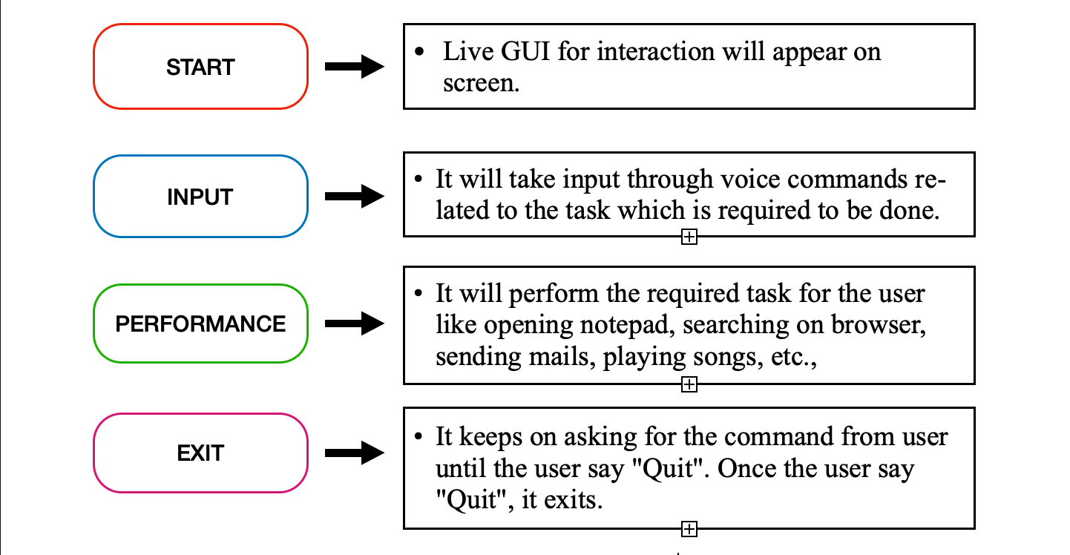
PROPOSED WORK
10

Slide 11
PROPOSED WORK -FEATURES
WINDOWS:
Face recognition login system
Sending email
To make video call
Finding IP address
Notifications from social accounts.
Sending social messages.
It can read PDF.
It can give desktop reminders of your choice.
It can open all the URL links.
It can take screenshots.
It can control system power activities(Eg: shutdown, restart, sleep).
It can open your OTT platforms accounts.
MAC OS:
It even works in offline
Sending email
Customise commands
Grids used for easy automated works
It can open your OTT platforms accounts.
It can take screenshots.
It can give desktop reminders of your choice.
11

Slide 12
LITERATURE REVIEW
Year & Publication | Authors | Title | Technique | Result
2020 - IEEE | Subhash S &Prajwal Srivatsa. | Artificial intelligence – based voice assistant | Artificial intelligent | Accuracy 89% and 70 ms
2019- Business & Information Systems Engineering 61.4 | Maedche, Alexander. | AI-based digital assistants. | Artificial intelligent | Basic GUI and accuracy 87% , time 120ms
2021 - Journal of Systems and Information Technology | Lee, One-Ki Daniel. | To Role of interaction quality and trust in use of AI-based voice-assistant systems. | Artificial intelligent & Neural networks | limited features And accuracy 90%, time 50 ms
2020 - IEEE | Natale, Simone. | To believe in Siri: A critical analysis of AI voice assistants. | critical analysis training model. | limited features And accuracy 90% Time 60ms
12

Slide 13
LITERATURE REVIEW
Year & Publication | Authors | Title | Technique | Result
2019- International Conference on Information Systems. | Hu, Peng, Kun Wang, and Jingwen Liu. | Speaking and listening: Mismatched human-like conversation qualities undermine social perception and trust in ai-based voice assistants. | Neural networks | No GUI And time 70 ms
2021- International Conference on Information Systems (ICIS). | Grünenfelder, Janay Ilya, Naim Zierau, and Andreas Janson. | Alexa, are you still there? Understanding the Habitual Use of AI-Based Voice Assistants. | Artificial intelligent | Basic GUI and accuracy 87% , time 120ms
2018-IEEE | Felix, Shubham Melvin, Sumer Kumar, and A. Veeramuthu. | A smart personal AI assistant for visually impaired people. | Artificial intelligent | Accuracy 89% and 80 ms
2021-IEEE | Karthick, S. | Virtual Personal/Voice based Assistant for an Institution through Alexa's skill. | critical analysis training model. | limited features And accuracy 90% Time 60ms
13

Slide 14
SYSTEM REQUIREMENTS
Personal computer.
Operating system (windows_x64 bit,mac,linux).
Internet connection.
Microphone and webcam.
Required modules which was given in requirements.txt file.
14

Slide 15
IMPLEMENTATION
We implemented in two operating systems - Windows and Mac OS.
In windows we use x64 bit architecture intel i3 processor, 8gb ram.
In Mac the config is m1 chip 8 gb ram.
15

Slide 16
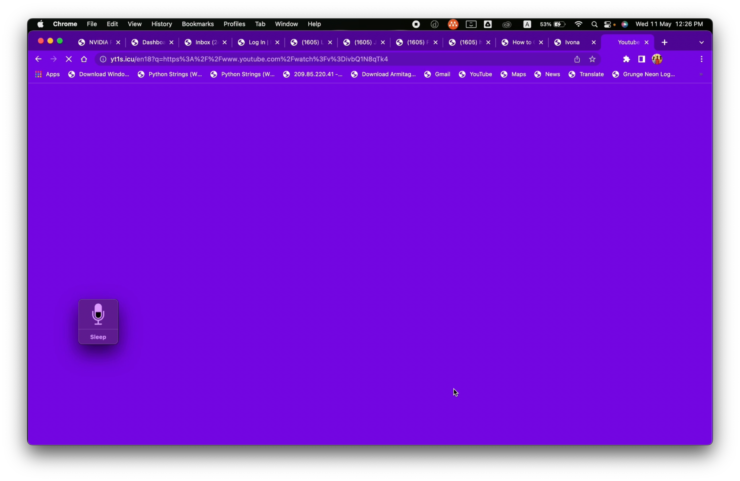
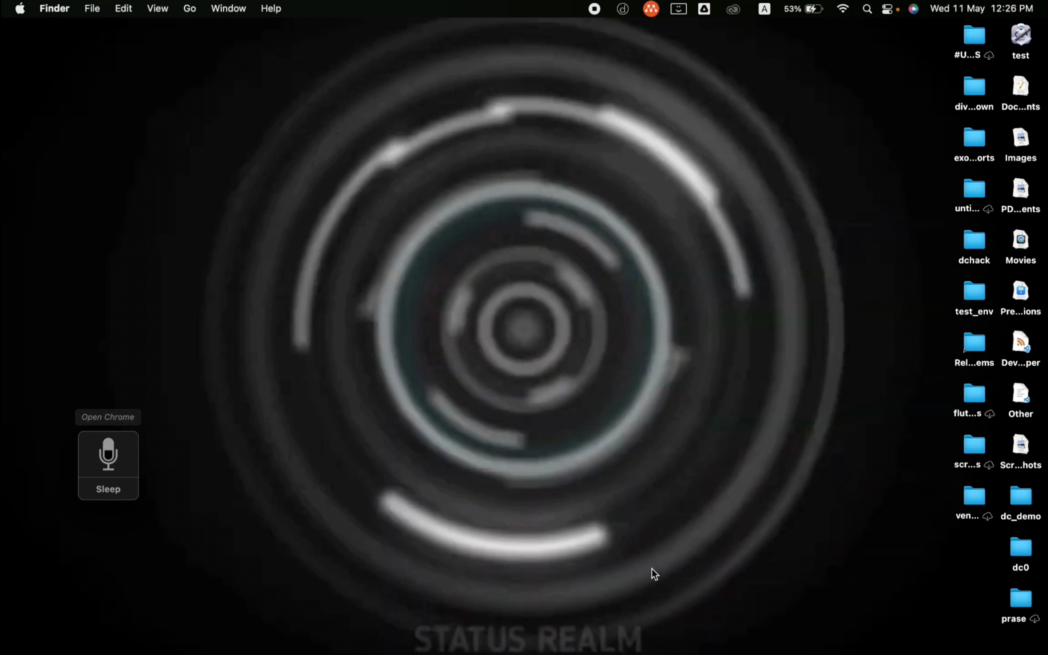
RESULTS ON MAC OS
Opens and close applications instant by voice
16

Slide 17
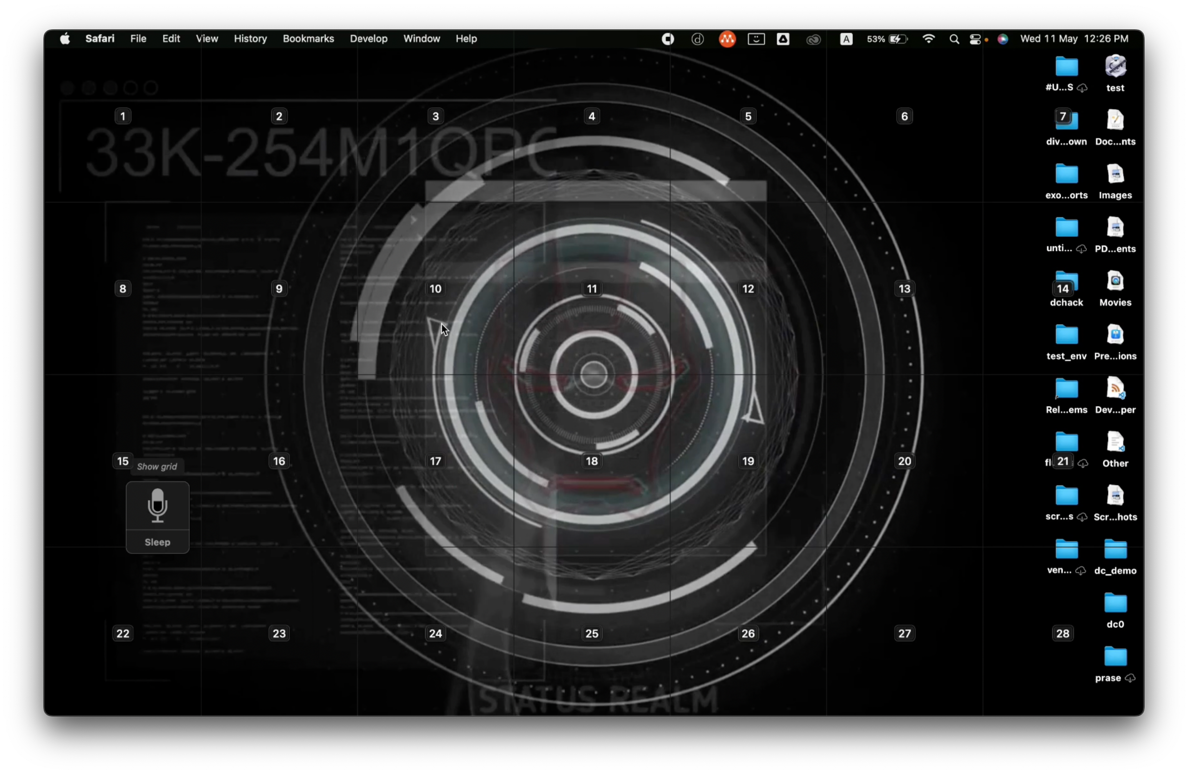
RESULTS ON MAC OS
It shows number grid for all other minute automations by voice.
16

Slide 18
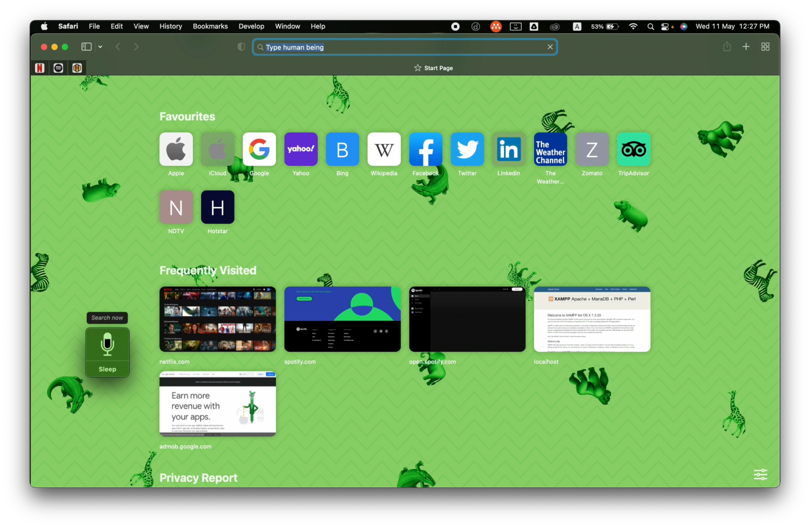
RESULTS ON MAC OS
Search anything and type anything by voice.
16

Slide 19
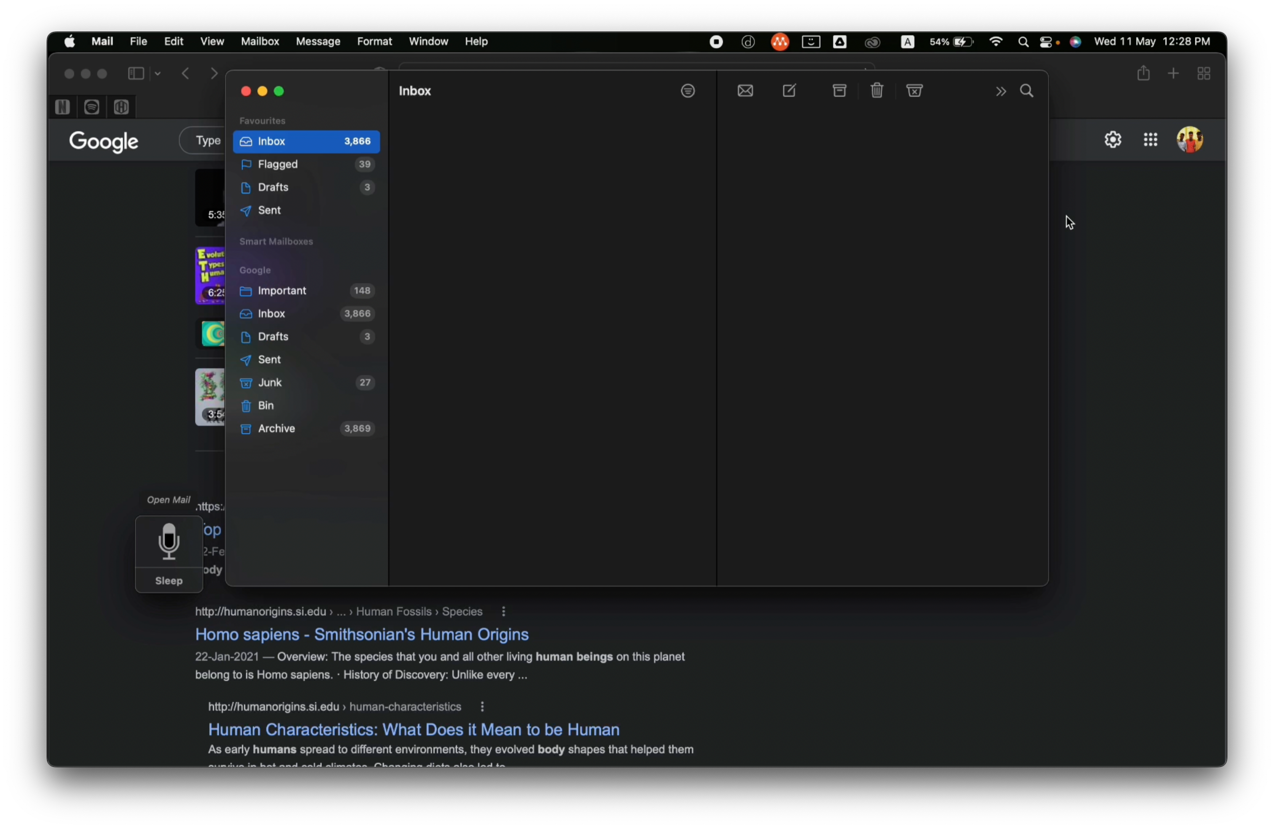
RESULTS ON MAC OS
Sent mail with file attachment by voice.
16

Slide 20
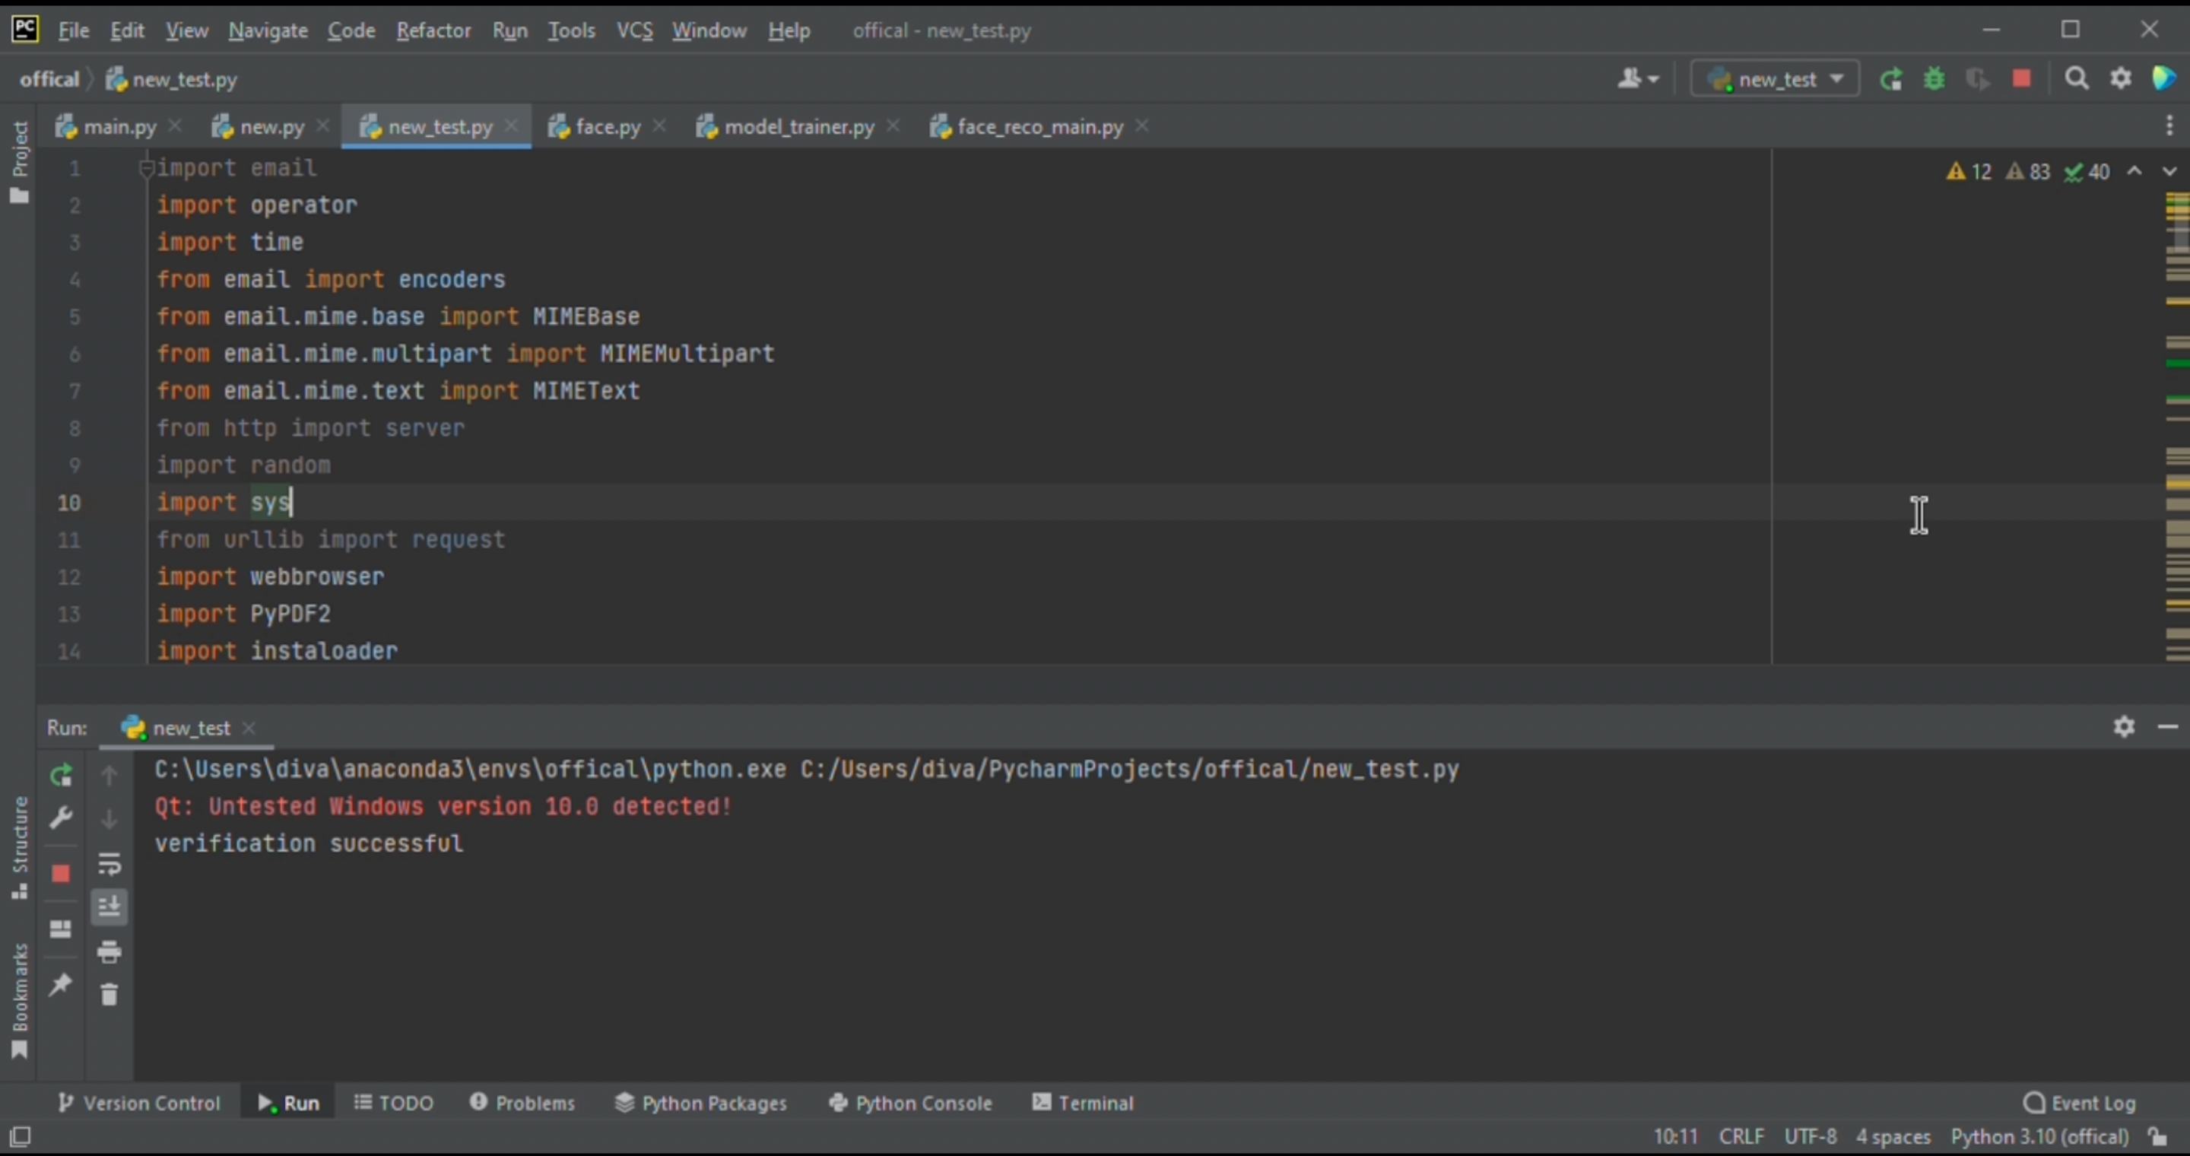
RESULTS ON WINDOWS
Face verification system
16

Slide 21
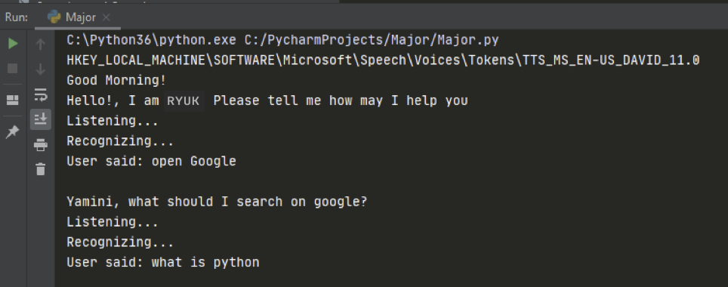
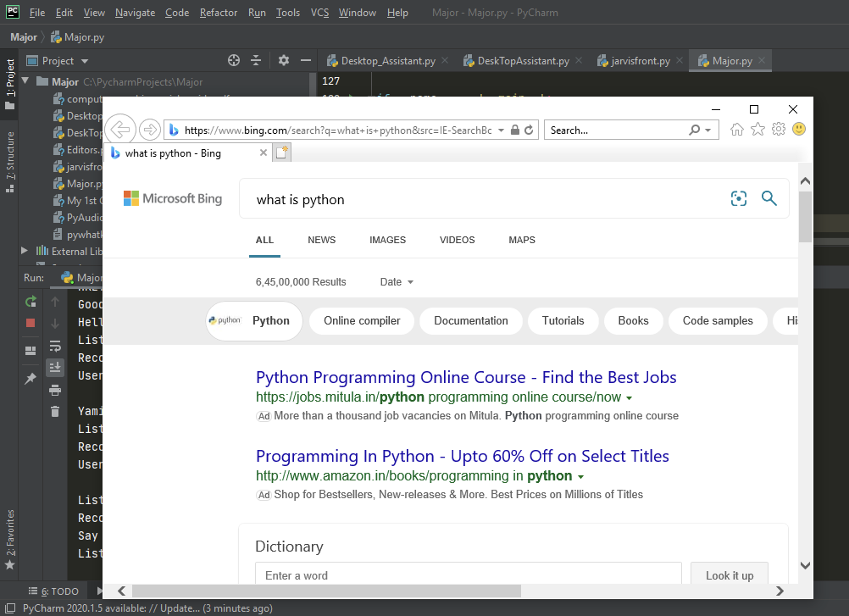
RESULTS ON WINDOWS
Opens google and search by voice.
16

Slide 22
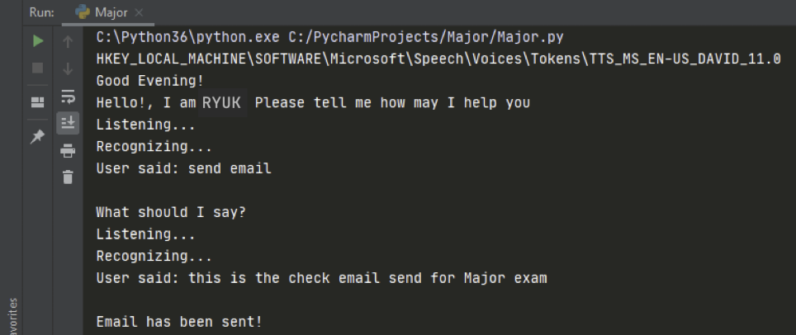
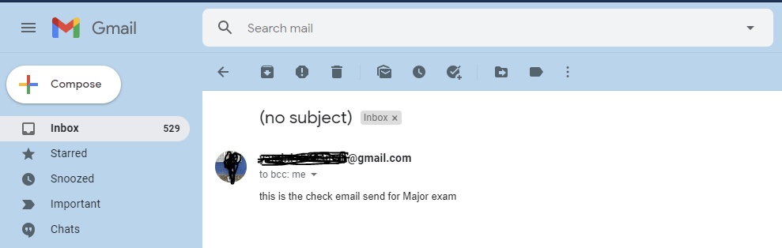
RESULTS ON WINDOWS
Sent mail with file attachment
by voice.
16

Slide 23
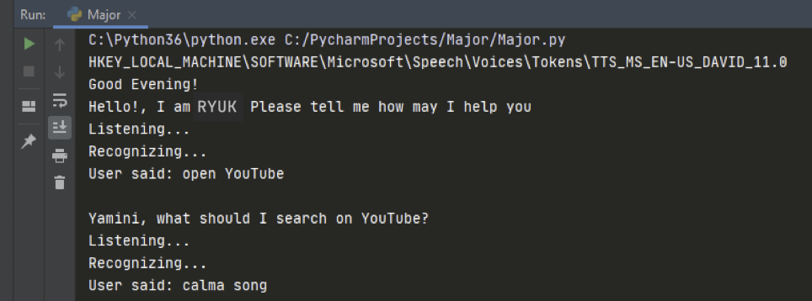
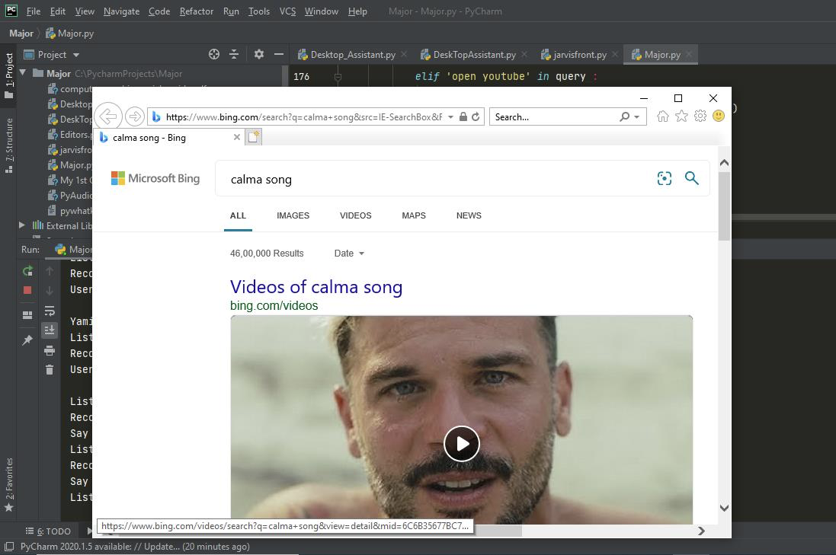
RESULTS ON WINDOWS
Search and play anything by voice in YouTube.
16

Slide 24
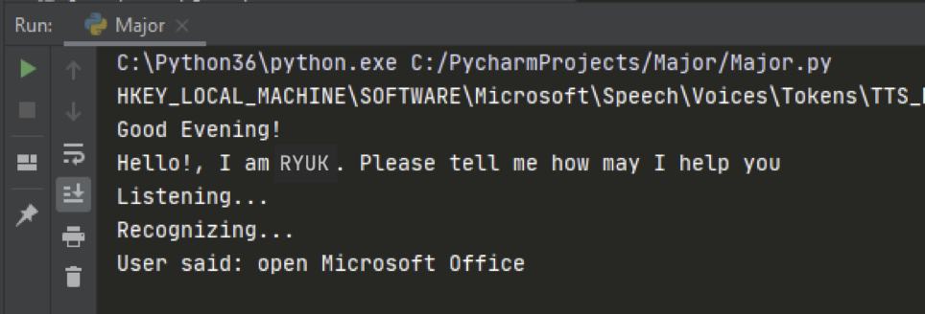
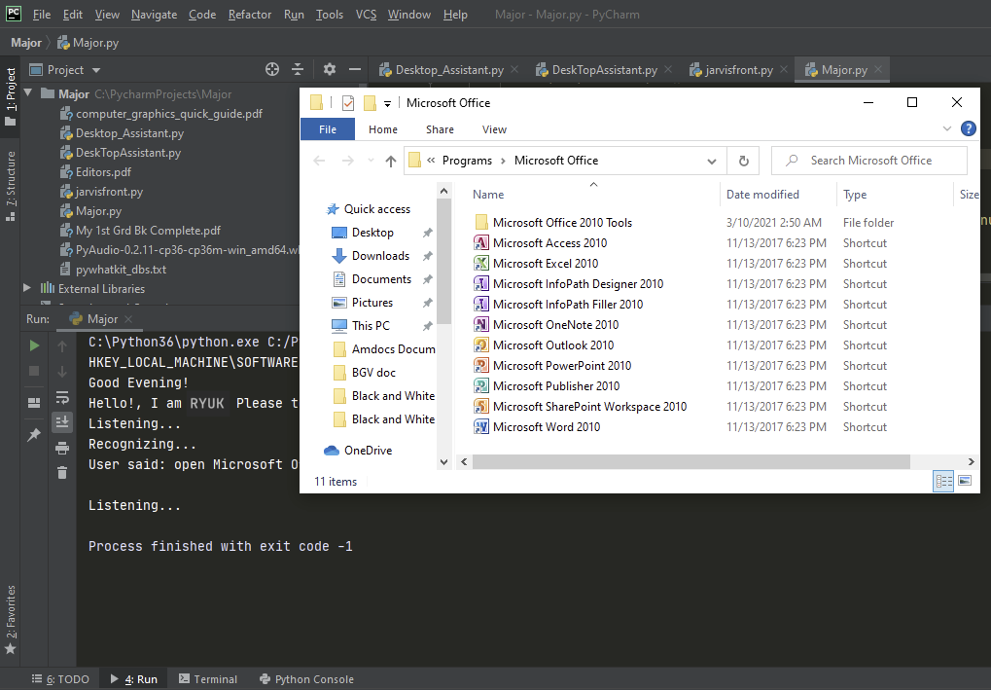
RESULTS ON WINDOWS
Open and close any apps by voice.
16

Slide 25
ADVANTAGES OF OUR PROPOSED SYSTEM
Saves time.
Enhanced Conversational interaction.
Fast Reactive nature.
Multitasking.
No Trigger phase.
No need for internet access
17

Slide 26
CONCLUSION
There can be no doubt that voice assistants are, and will continue to become, a great feat of human ingenuity and they are already creeping into our lives in some shape or form. With the eventual roll-out of 5G and the improvement in machine learning voice assistants may be setting themselves up to be a tool we cannot live without.
However, before we get to that stage, there are hurdles to cross which include heavy investment, improvement in the technology and confidence from consumers that this device that is in their lives does not pose a risk to their privacy.
18

Slide 27
REFERENCES
[1] Saadman Shahid Chowdury, Atiar Talukdar, Ashik Mahmud, Tanzilur Rahman “Domain specific Intelligent personal assistant with bilingual voice command processing” IEEE 2018.
[2] Polyakov EV, Mazhanov MS, AY Voskov, LS Kachalova MV, Polyakov SV “Investigation and development of the intelligent voice assistant for the IOT using machine learning”Moscow workshop on electronic technologies, 2018.
[3] Khawir Mahmood, Tausfer Rana, Abdur Rehman Raza “Singular adaptive multi role intelligent personal assistant (SAM-IPA) for human computer interaction” International conference on open source system and technologies, 2018.
[4] Natale, Simone. "To believe in Siri: A critical analysis of AI voice assistants." (2020): 1-17.
19

Slide 28
[5] Maedche, Alexander, et al. "AI-based digital assistants." Business & Information Systems Engineering 61.4 (2019): 535-544.
[6]Felix, Shubham Melvin, Sumer Kumar, and A. Veeramuthu. "A smart personal AI assistant for visually impaired people." 2018 2nd International Conference on Trends in Electronics and Informatics (ICOEI). IEEE, 2018.
[7] Grünenfelder, Janay Ilya, Naim Zierau, and Andreas Janson. "Alexa, are you still there? Understanding the Habitual Use of AI-Based Voice Assistants." International Conference on Information Systems (ICIS). 2021.
[8] Karthick, S., et al. "Virtual Personal/Voice based Assistant for an Institution through Alexa's skill." Materials Today: Proceedings (2021).
[9] Hu, Peng, Kun Wang, and Jingwen Liu. "Speaking and listening: Mismatched human-like conversation qualities undermine social perception and trust in ai-based voice assistants." (2019).
20

Slide 29
Thank you
21

